Slide 1
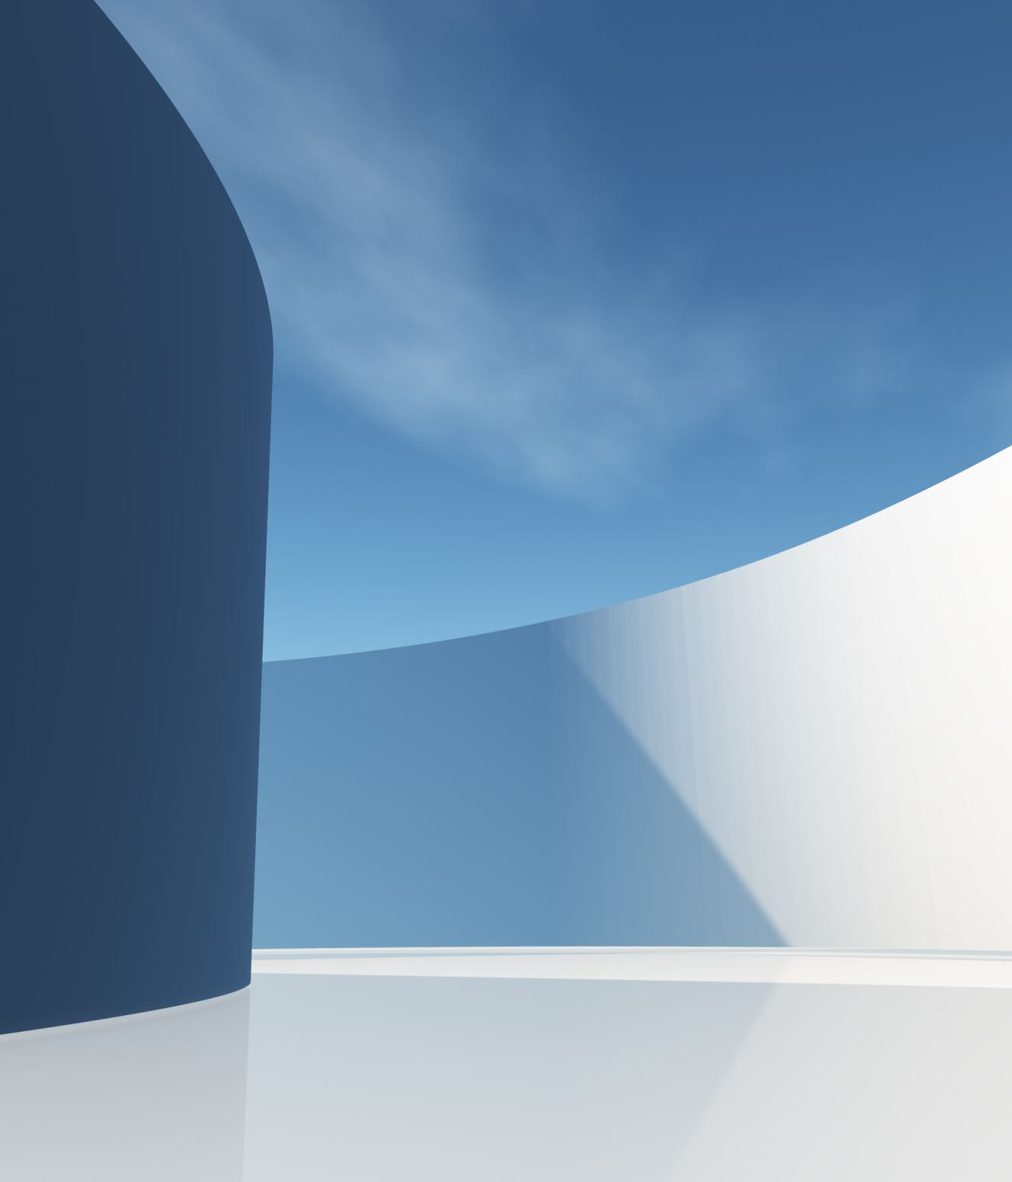
Cyper Security
GUI For Encrypt and Decrypt codes
From/ Mahmoud Shawqy
Mo'men fayez
Mostafa Ahmed
To/ DR/ Abdelhameed

Slide 2
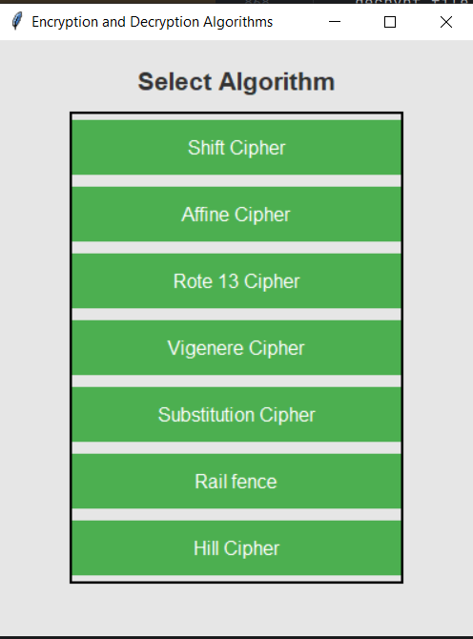
Main Page

Slide 3
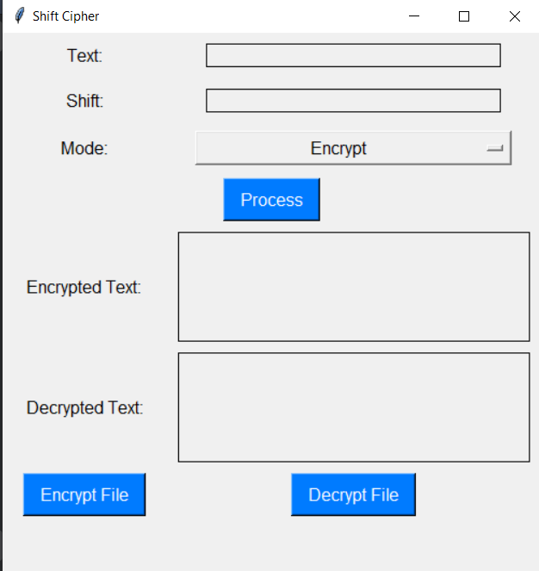
The First Algorithm(shift cipher)

Slide 4
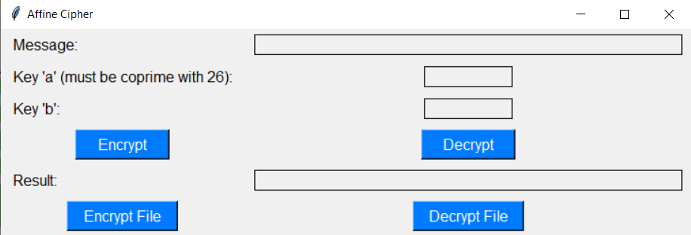
The second Algorithm(Affine Cipher)

Slide 5
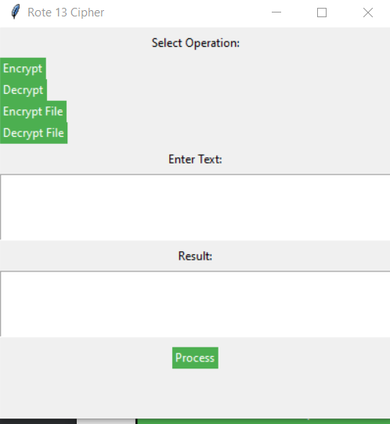
The Third Algorithm(Rot 13)

Slide 6
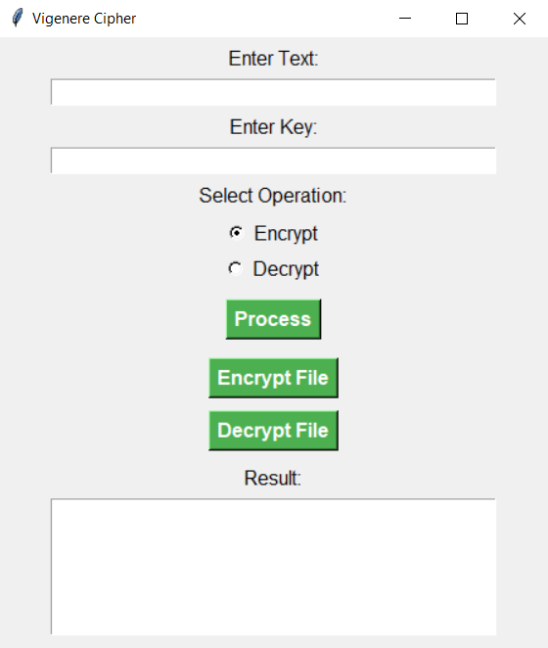
The Fourth Algorithm(Vigenere Cipher)

Slide 7
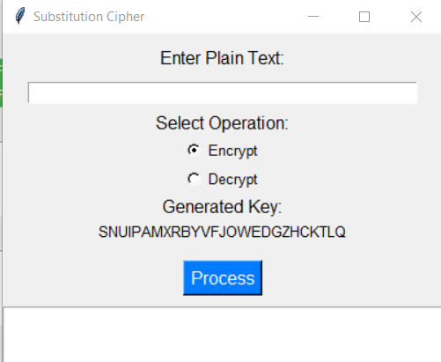
The Fifth Algorithm(Substitution Cipher)

Slide 8
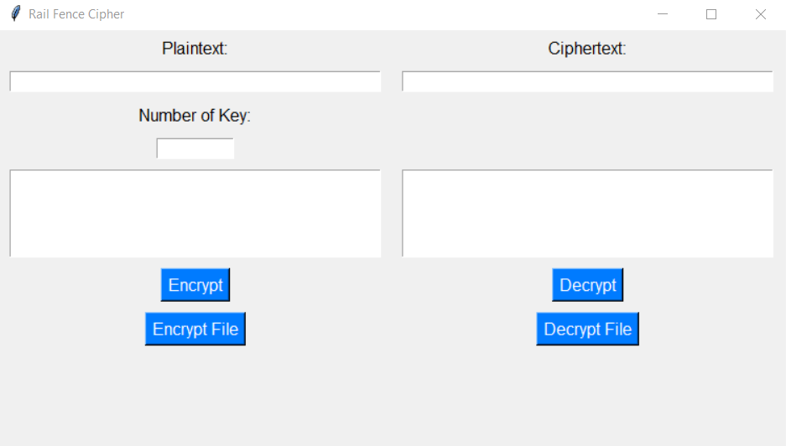
The Sixth Algorithm( Rail fence cipher)

Slide 9
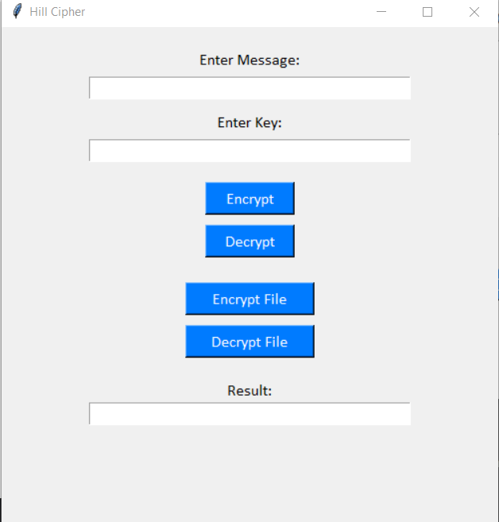
The Seventh Algorithm(Hill Cipher)

Slide 10
Thank You

